Slide 1
Sylvan Hills Middle SChooL Budget Feedback Meeting
To be presented to GO Team BEFORE the school staffing conference

Slide 2
Norms
This is a meeting of the GO Team. Only members of the team may participate in the discussion. Any members of the public present are here to quietly observe.
We will follow the agenda as noticed to the public and stay on task.
We invite and welcome contributions of every member and listen to each other.
We will respect all ideas and assume good intentions.

Slide 3
GO Team Budget Development Process
YOUR SCHOOL STRATEGIC PLAN…
is your roadmap and your role.
It is your direction, your priorities, your vision, your present, your future.
Step 1: Data Review
Step 2: Strategic Plan Review
Step 3: Budget Parameters
(Strategic Priorities)
Step 4: Budget Choices
Notes:
Today I will provide an overview of the budget allocations for FY23. We will begin the work of funding the strategic priorities we agreed upon during our strategic review meeting. (IF YOU HAVE NOT DECIDED ON YOUR PRIORITIES, YOU WILL SAY – WE WILL DECIDE ON OUR PRIORITIES AND THEN DISCUSS ALLOCATING FUNDS TO ADDRESS THOSE PRIORITIES).

Slide 4
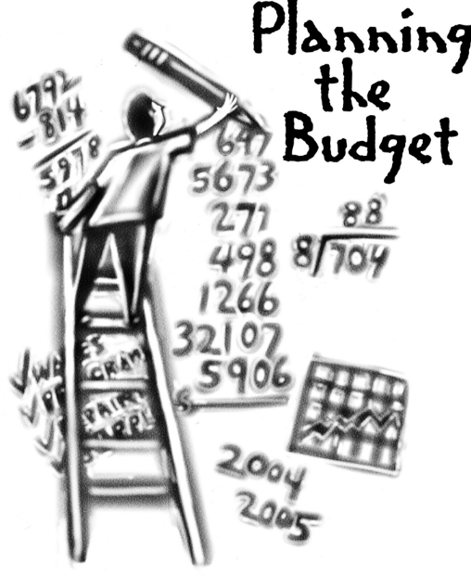
Overview of FY ‘24 GO Team Budget Process
Step 1 Review and Update Strategic Plan and Rank Strategic Priorities
By end of Fall Semester
Step 6 Principals: HR Staffing Conferences Begin
Late February – Early March
Step 3 GO Team Initial Budget Session: Allocation
January 24 – early February
Step 7 GO Team Final Budget Approval Meeting
Budgets Approved by March 17
Step 5
GO Team Feedback Session: Draft Budget Presented & Discussed February – multiple meetings, if necessary
Step 4 Principals: Associate Supt. Discussions and Review
February (supports needed, specific challenges, coaching)
Step 2 Principals: Workshop FY 24 Budget
January 24
GO Teams are encouraged to have ongoing conversations

Slide 5
Budget Feedback Meetings
What
The GO Team feedback session(s) should be scheduled for the principal to provide an overview of the school’s draft budget for the GO Team members and the general public.
Why
This meeting provides an opportunity for GO Teams to discuss how the school’s budget has been allocated to support the programmatic needs and key strategic priorities.
When
Meetings must be held in February before staffing conferences. May be combined with the allocation meeting (as needed), if the GO Team has completed strategic plan updates and ranked strategic priorities.
Notes:
Looking for general consensus prior to Staffing Conferences

Slide 6
FY24 Budget Parameters
FY24 School Priorities | Rationale
Increase the percent of students in grades 6-8 scoring proficient or above on the ELA GMAS by 3% from 15.3% to 18.3% by June 2023. | Implement the coaching cycle to improve instruction based on classroom observation and student performance.
Increase the percent of students in grades 6-8 scoring proficient or above on the MATH GMAS by 3% from 15% to 18% by June 2023.. | Provide differentiated job-embedded professional learning on curricular resources (amplify, text, etc)
Attend to the mental and social well being of students in order to Increase student attendance (CCRPI) from 79.3% to 85% by June 2023. | The CARE Team will refine and monitor attendance initiatives and student wellness with comprehensive wrap around supports.
Notes:
Review the priorities that the GO Team has developed and the rationale for these priorities. Feel free to copy this slide if you have more than 3 priorities to account for.

Slide 7
Descriptions of Strategic Plan
Breakout Categories
Priorities: FY24 funding priorities from the school’s strategic plan, ranked by the order of importance.
APS Five Focus Area: What part of the APS Five is the priority aligned to?
Strategies: Lays out specific objectives for schools improvement.
Request: “The Ask” What needs to be funded in order to support the strategy?
Amount: What is the cost associated with the Request?

Slide 8
FY24 Strategic Plan Break-out
Priorities | APS FIVE Focus Area | Strategies | Requests | Amount
Improve students reading/language arts/writing performance | Curriculum & Instruction | Implement the use of a Lesson Internalization & Data Analysis Protocol to inform instructional planning | 6 ELA Teacher 1 ELA/Intervention | 636,433
Increase the percent of students in grades 6-8 scoring proficient or above on the MATH GMAS by 3% from 15% to 18% by June 2023. | Curriculum & Instruction | Implement the coaching cycle to improve instruction based on classroom observation and student performance. | 2 Math Teachers 4 REP Math Teachers 1 Math/Intervention Teacher | 636,433
Attend to the mental and social well being of students in order to Increase student attendance (CCRPI) from 79.3% to 85% by June 2023. | Whole Child Intervention | The CARE Team will refine and monitor attendance initiatives and student wellness with comprehensive wrap around supports. | 2 School Counselors 1 School Social Worker | 334,263
Notes:
For the next few slides, I will show you how I have allocated the budget to support our strategic priorities.
Based on our strategic priorities and funds we received, here is a break-out of the priorities, which focus area it addresses, the strategies that will be implemented, the purchase request, which funding source was used and the amount.

Slide 9
Plan for FY24 CARES Allocation $211,261
Priorities | APS FIVE Focus Area | Strategies | Requests | Amount
Attend to the mental and social well being of students in order to Increase student attendance (CCRPI) from 79.3% to 85% by June 2023. | Whole Child Intervention | The CARE Team will refine and monitor attendance initiatives and student wellness with comprehensive wrap around supports. | 1 Behavior Specilaist | 112,251
Increase the percent of students in grades 6-8 scoring proficient or above on the ELA GMAS by 3% from 15.3% to 18.3% by June 2023. | Curriculum & Instruction | Implement the coaching cycle to improve instruction based on classroom observation and student performance. | 1 ELA Teacher | 97,860
Notes:
For the next few slides, I will show you how I have allocated the budget to support our strategic priorities.
Based on our strategic priorities and funds we received, here is a break-out of the priorities, which focus area it addresses, the strategies that will be implemented, the purchase request, which funding source was used and the amount.

Slide 10
Plan for FY24 Title I Family Engagement Funds
$ 11,000
Priorities | APS FIVE Focus Area | Strategies | Requests | Amount
Build community partnerships to provide families access to mental health and wellness services | Whole Child Intervention | Build partnership with Family Ties to provide mental health services to students and families. | Hourly – Parent Liaison | $12,854.16
Notes:
For the next few slides, I will show you how I have allocated the budget to support our strategic priorities.
Based on our strategic priorities and funds we received, here is a break-out of the priorities, which focus area it addresses, the strategies that will be implemented, the purchase request, which funding source was used and the amount.

Slide 11
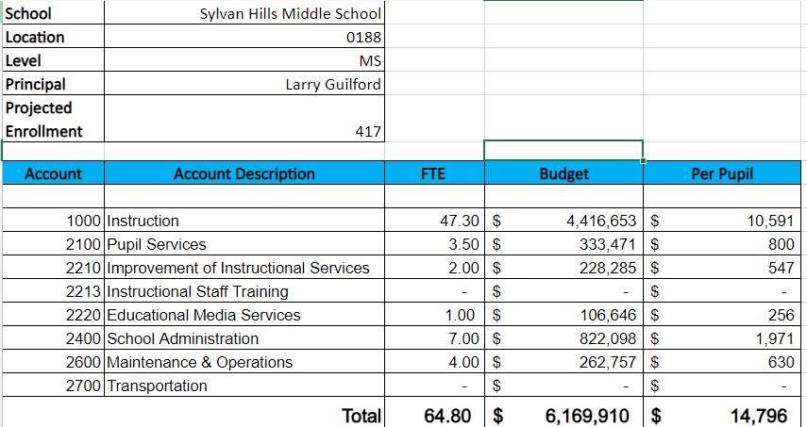
Budget by Function (Required)
*Based on Current Allocation of School Budget
Notes:
I am passing out the definitions for these funding categories. You will see what makes up each category. Although the school’s total budget amount will not change, allocation per function may change depending on our conversations and school needs.

Slide 12
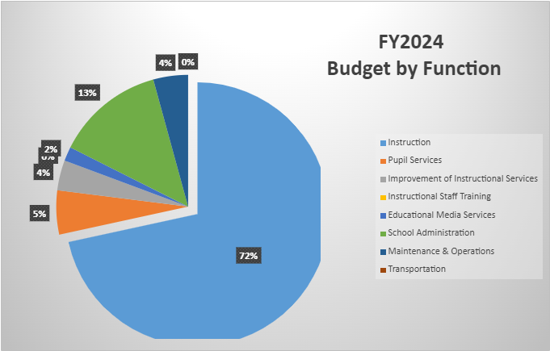
Budget by Function (Required)
*Based on Current Allocation of School Budget
Notes:
Explain the pie chart and allocations

Slide 13
Discussion of reserve and Holdback funds

Slide 14
Plan for FY24 Leveling Reserve
$ 71,038
Priorities | APS FIVE Focus Area | Strategies | Requests | Amount
Increase the number of students enrolled in higher level and STEM/STEAM classes | Signature Programming |  | .50 (Signature Programs Specialist) | 71,038
Notes:
For the next few slides, I will show you how I have allocated the budget to support our strategic priorities.
Based on our strategic priorities and funds we received, here is a break-out of the priorities, which focus area it addresses, the strategies that will be implemented, the purchase request, which funding source was used and the amount.

Slide 15
Questions for the GO Team to Consider and Discuss
Are our school’s priorities (from your strategic plan) reflected in this budget?
Are new positions and/or resources included in the budget to address our major priorities?
Do we know (as a team) the plan to support implementation of these priorities beyond the budget (ex. What strategies will be implemented)?
What tradeoffs are being made in order to support these priorities?
How are district and cluster priorities reflected in our budget?
Cluster priorities- what staff, materials, etc. are dedicated to supporting our cluster’s priorities?
Signature programs- what staff, materials, etc. are dedicated to supporting our signature program?
Are there positions our school will share with another school, i.e. nurse, counselor?
Notes:
CHAIR - Our final task for today! Here are questions that we need to consider to ensure we have a good working draft budget. Let’s walk through them together.

Slide 16
Where We’re Going?
Our next meeting is the Budget Approval Meeting
What:
During this meeting we will review the budget, which should be updated based on feedback from the staffing conference, Associate Superintendents, and key leaders. After review, GO Teams will need to take action (i.e., vote) on the FY24 Budget.
Why:
Principals will present the final budget recommendations for GO Team approval.
When:
All approval meetings must be held after staffing conferences. Budgets must be approved by March 17th.

Slide 17
What’s Next?
February
HR Staffing Conferences (Late February)
March
Final GO Team Approval Meeting (AFTER your school’s Staffing Conference and BEFORE Friday, March 17th)
Notes:
In February, we will meet again to discuss how the school’s budget has been allocated to support the programmatic needs and FY23 key strategic priorities.
If think we need to continue our budget conversations, we will schedule additional meetings. My goal is to make sure your voices are reflected in our school’s budget.
I will also be meeting with my Associate Superintendent, program managers and other key leaders to go over our budget and to make sure the school is meeting the standards of service and appropriately staffing.
During the week of Feb. 24th -March 2nd , HR Staffing Conferences will be held. At this meeting, I will present my plan for staff utilization, resource distribution and plan for staffing implications.
We will need to approve the budget at the ________ meeting.

